Slide 1
Monitoring Public Sentiment of NFL Draft Picks via Machine Learning
Jonathan Wiseman
SCAD 2020
https://github.com/jonwiseman/DraftSense

Slide 2
Outline
Introduction and Aim
NFL Draft
Reddit and r/NFL
Sentiment Analysis
Aggregate Forecasting
Dataset
Collection
Cleaning
Labelling
Dataset Exploration
Language of the NFL Draft
Reddit’s Unique Language
Model Creation
Sentence Embedding
Machine Learning
Conclusion
The Good
The Bad
Future Work

Slide 3
Introduction and Aim
Football, Forecasting, and Language

Slide 4
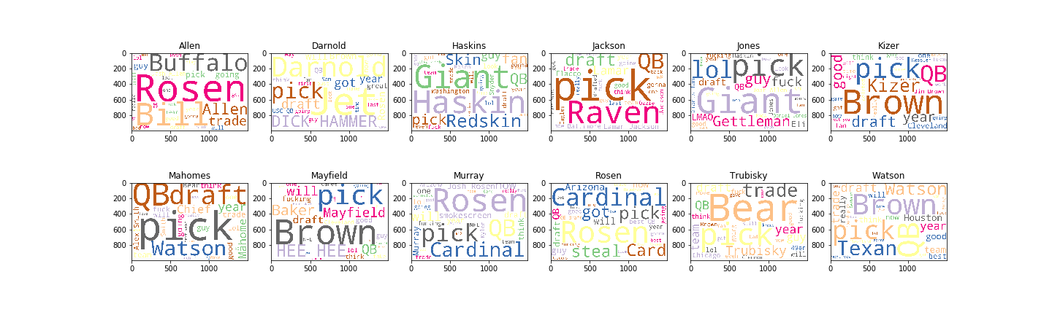

Slide 5
What You Just Saw
Word clouds: visualizations of the most popular words and phrases in a text collection
Each word cloud represents comments made about a quarterback after his selection in the NFL Draft
The source? Reddit’s r/NFL community

Slide 6
Some Thoughts
After looking at those word clouds, I have some thoughts…
How does the language used to discuss draftees differ?
Can we detect if these opinions are positive or negative?
Is the public any good at gauging how good a draft pick is?
Can we use these opinions in any meaningful way?

Slide 7
Answering These Questions…
We’ll need to explore some interesting topics in machine learning and forecasting
There are two big ones we need to understand:
Sentiment Analysis
Aggregate Forecasting
But first, let’s make sure we’re all on the same page…

Slide 8
Background: the NFL Draft
Annual event in which college players are selected by pro teams
Draft order is determined by previous season’s performances
High draft pick: first two rounds; particularly first 10 picks
Some useful terminology:
Steal: great value pick for the position
Bust: high pick, likely failure
Reach: high pick, questionable value

Slide 9
Sentiment Analysis
Automatic extraction of standpoint, view, and mood of an author
Common applications:
Marketing
Product reviews
Additional input for search engines
Our application: determining the polarity of a Reddit comment
Polarity: positive or negative

Slide 10
Why?
Aggregate forecasting: combining a number of different forecasts performs better than any individual forecast
For us: get a grip on public reaction to a draft pick based on thousands of individual comments
Further application: measuring future success of draftees based on initial reaction

Slide 11
Dataset
Scraping, Cleaning, and Labeling Thousands of Reddit Comments

Slide 12
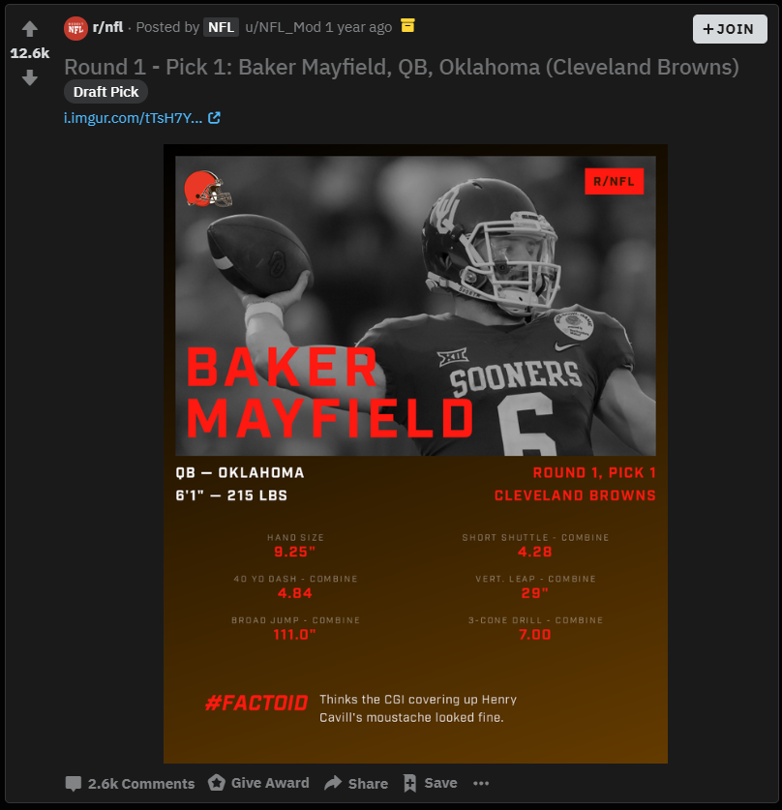
Source
Reddit is a popular news aggregation and content hosting website
r/NFL is a subreddit dedicated to all things professional football
An auto-moderator posts a dedicated thread for draft picks
Each thread accrues comments that reflect on the draft pick
An example of an auto-mod draft thread

Slide 13
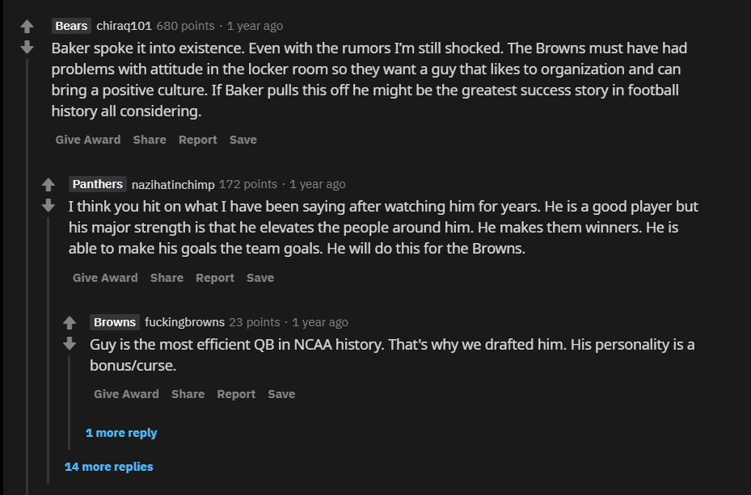
Comment Scraping
To get a more directed target, I decided to scrape comments from QB draft threads
Scraped all first-level and all second-level comments
Chose 12 players from the past three years

Slide 14
Comment Cleaning
However, not every comment is ready to use as-is
There are undesirable or unusable features: emojis, hyperlinks, or links to other users/places on Reddit
While using emojis would be very helpful, most existing language processing models don’t handle them
So, we have to clean our dataset before it can be used
Major steps:
Remove emojis
Remove URLs
Number signs and hashtags
Quotation marks
Brackets, parentheses
Slashes
Asterisks

Slide 15
Comment Labelling
In total, there were ~15,000 comments
But, none of these comments are explicitly labeled
In order for a computer to learn if a comment is positive or negative, it needs to know what it actually is
As such, I heroically labeled each comment
What if a comment is not explicitly positive or negative?
Two other categories: jokes/memes and irrelevant
What makes a comment irrelevant?
Discusses other players, coaches, or trades
What makes a comment a joke?
Used personal judgement

Slide 16
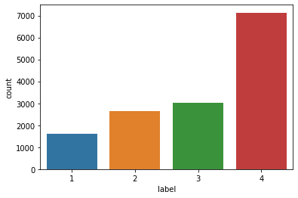
Labelling Results
Positive: 1616
Negative: 2652
Jokes/memes: 3035
Irrelevant: 7131

Slide 17
Dataset Exploration
Compliments, Insults, and Jokes

Slide 18
Exploring the Language of the Draft
What makes a positive comment different from a negative comment?
Are there shared jokes that get applied to every player?
How harsh is the language used to insult draft picks?

Slide 19
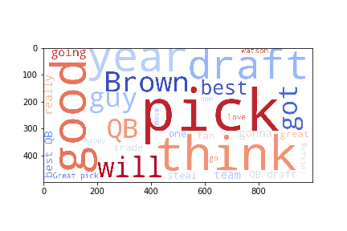
Our Most Beloved Players…
Deshaun Watson (250) and Josh Rosen (241) received the most positive comments
Josh Allen (55) received the fewest
Trends:
Evaluation words: good, best, great
Specific lingo: steal, trade, QB
Words about the future: gonna, go, will
Very few expletives

Slide 20
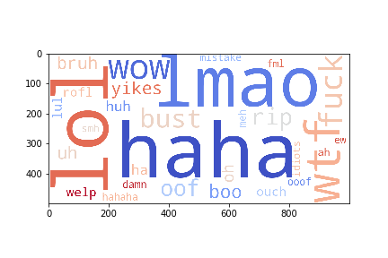
Our Most Reviled Players
Daniel Jones (879) and Mitchell Trubisky (611) were the most hated players on r/NFL
Josh Rosen (34) received the fewest negative comments
General trends:
LOTS of profanity
Emotional language: anger
TONS of single-word reactions: bust, bad, wow, oh

Slide 21
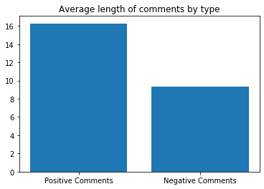
Interesting Trends in Negative Language
In fact, negative comments are significantly shorter than positive comments
Total number of characters in each category:
Positive: 26,305
Negative: 24,718
Despite having significantly more data, there is less total negative text
On average, negative comments are also significantly shorter than positive ones

Slide 22
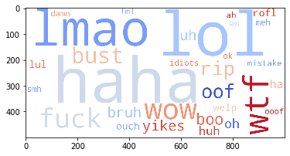
Looking at One-Word Comments
Since so many negative comments are a single-word, it is interesting to explore them
There are a ton of duplicates:
What’s the difference between HAHAHAH and HAHAHAHAHAHA?
For an eventual model, nothing
Take a look at the most popular ones after consolidating

Slide 23
Model Creation
Sentence Embedding, Sentiment Analysis, and Performance

Slide 24
How to Represent Words and Sentences
Most machine learning models take numeric vectors as input
But we’ve got words
And not every comment is the same length
It is possible to represent a word vector (a sequence of words) as a number
Couple of approaches:
Bag of words: big matrix of documents (columns) and words (rows); 1 if present and 0 if absent (or maybe weighted somehow)
Embedding:
Word: create vectors such that similar words are closer together (with some distance metric)
Sentence: train a neural network to predict the next word in a sentence/document

Slide 25
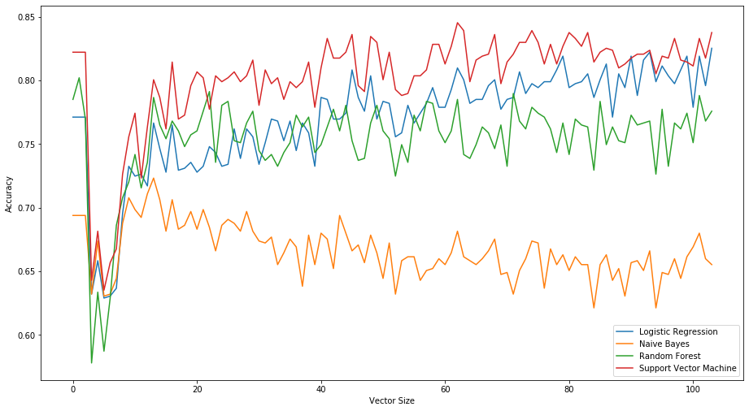
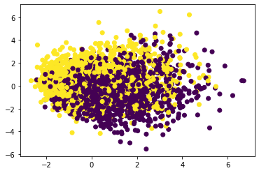
Sentence Embedding
Sent2Vec: represent variable length pieces of text as numeric vectors
Neural network trained on your dataset
Implementation: GenSim
Search for ideal embedding dimension based on sentiment analysis performance
Somewhere around 60-70 for this task and dataset

Slide 26
Model Training
Four models were tested:
Logistic regression: ~77% accuracy
Naïve Bayes: ~65%
Random Forest: ~77%
Support Vector Machine: ~84%
Support vector machine performs the best with a vector size of 62
What does this mean?
We have a trained model that can determine if a comment is positive or negative about 84% of the time
Could we do better?
Parameter tuning
Gathering a larger dataset
Using different embedding algorithms

Slide 27
Conclusion
The Good, the Bad, and Future Work

Slide 28
The Good
Creation of a publicly available sentiment analysis dataset focused on football
Labels were of high enough quality for a simple sentiment analysis task
Achieved ~85% accuracy
Interesting language visualizations

Slide 29
The Bad
15,000 comments, only about 4,000 usable
Manual labelling: subjectivity and extremely slow speed
Only used one sentence embedding algorithm

Slide 30
Future Work
Exploration of more embedding algorithms
Comparison between reaction and eventual QB performance
Live application: 2020 draft
Multi-class classification: detecting joke and irrelevant comments
Expanded dataset
Help with labeling: multiple reviewers for each comment

